Slide 1
Capstone Project - 1 Global Terrorism Analysis Team Members Kota Lakshmana Rao A S Suchithra Puneet Aggarwal

Slide 2



Global Terrorism
Terrorism poses a direct threat to the security of the citizens of NATO countries, and to international stability and prosperity. It is a persistent global threat that knows no border, nationality or religion. The idea of this project is to create a Exploratory Data Analysis report through which we can identify the most affected region, pattern of attack and weapons used in Terrorist activities. We divided whole analysis in four parts as follows:. It is a persistent global threat that knows no border, nationality or religion, and is a challenge that the international community must tackle togetherTerrorism poses a direct threat to the security of the citizens of NATO countries, and to international stability and prosperity. It is a persistent global threat that knows no border, nationality or religion, and is a challenge that the international community must tackle together

Slide 3

Global terrorism Analysis
1.) Defining Problem Statement
2.) Importing libraries
3.) Descriptive Statistics
4.) Missing value imputation
5.) Graphical representation

Slide 4
Points for Discussion
1.Terrorist attack on each year
2.Most terrorist attack country
3.Terrorist attack on region wise
4.Number of people killed
5.Number of persons wounded
6.Terrorist attack on citywise
7.Terrorist attack type
8.Terrorists targets
9.Type of weapon used 10.Discussion on frequent attack data

Slide 5
Data Analysis Steps
Import Libraries: In this part, we had imported require libraries to perform Exploratory Data Analysis for Global Terrorism dataset
Descriptive Statistics: In this part, we start by looking at descriptive statistic parameters for the dataset. We will use describe() for this
Missing Value Imputation: We will now check for missing values in our dataset. In case there are any missing entries, we will impute them with appropriate values
Graphical Representation: We will start with Univariate Analysis. We will be using a bar graph for this purpose.

Slide 6
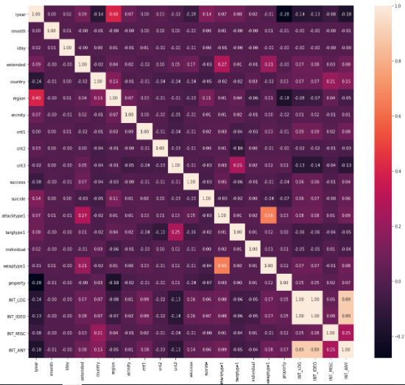
EDA
1.) Heatmap conclude that correlationship
between any two columns
2.) some data part of Heatmap is having
positive correlation
3.) some data part of Heatmap is having
negative correlation

Slide 7
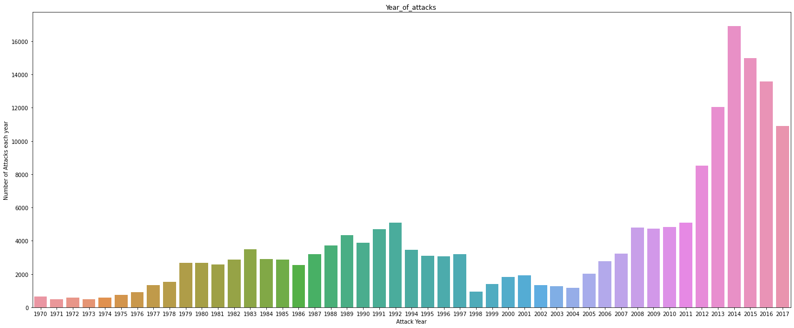
EDA
1.) Bar diagram we can conclude
that number of frequent terrorist
attacks in each year
2.) Most frequently Terrorist
attacks happen in 2014

Slide 8
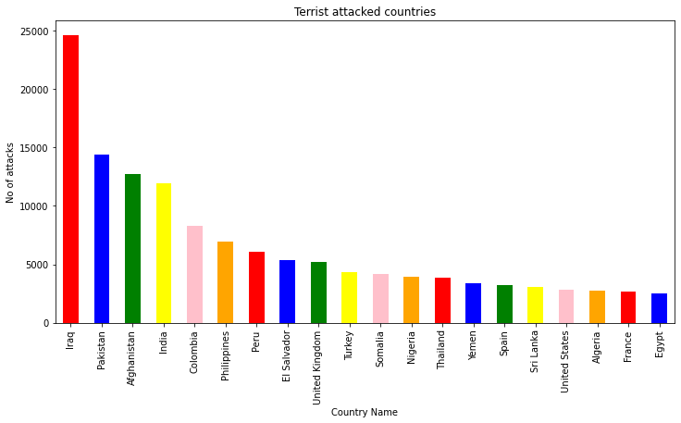
EDA
1.) In this Bar diagram, we concluded
that "IRAQ" is first place in top
20 most terrorist attacked country
2.) Number of attacks from
1970 to 2017 in IRAQ were 24636
3.) Minimum number of terrorist attack
happen in "Egypt" ,
4.) Number of attacks happen in Egypt
were 2479.

Slide 9
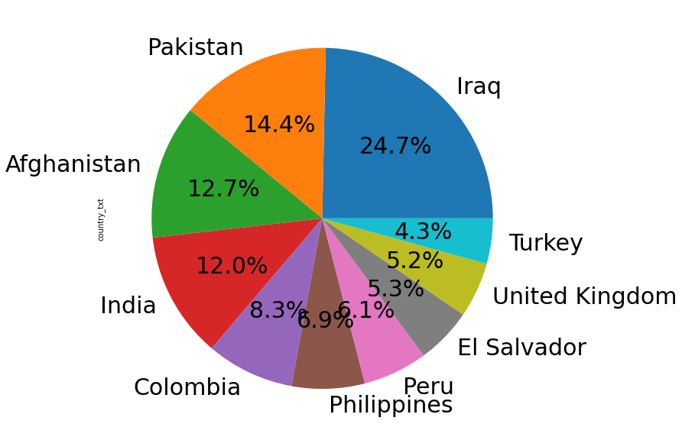
EDA
1.) Pie chart tells that "IRAQ“ is the
top 10 most terrorist attacked country
2.) IRAQ total percentage is 24.7%
3.) When compared to all other countries,
"Turkey" is the lowest attacked
country, its percentage is 4.3%

Slide 10
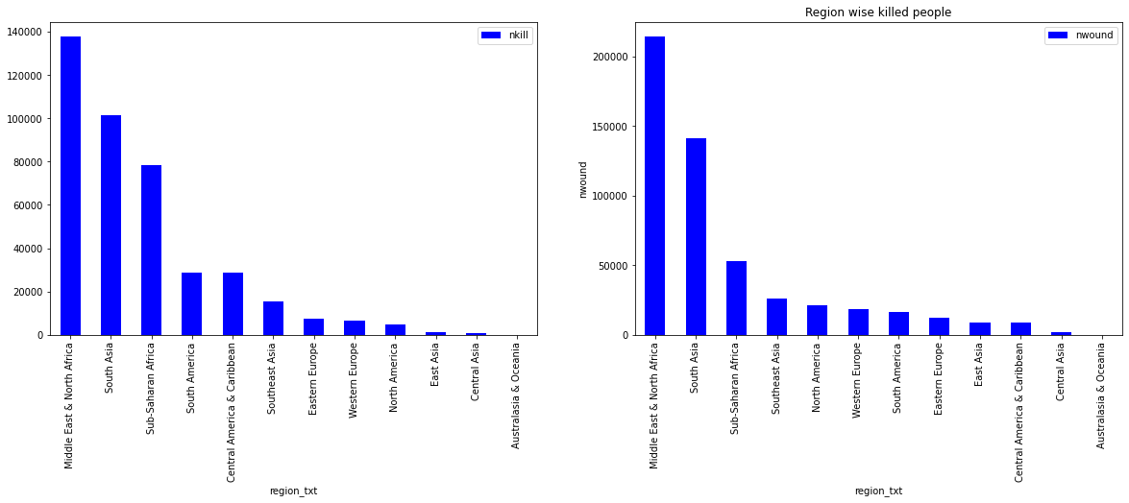
EDA
1.) From bar diagram We can conclude that most people killed in Middle East & North Africa its number was 1,37,642
2.) Most people wounded in Middle East & North Africa its number was 214308

Slide 11
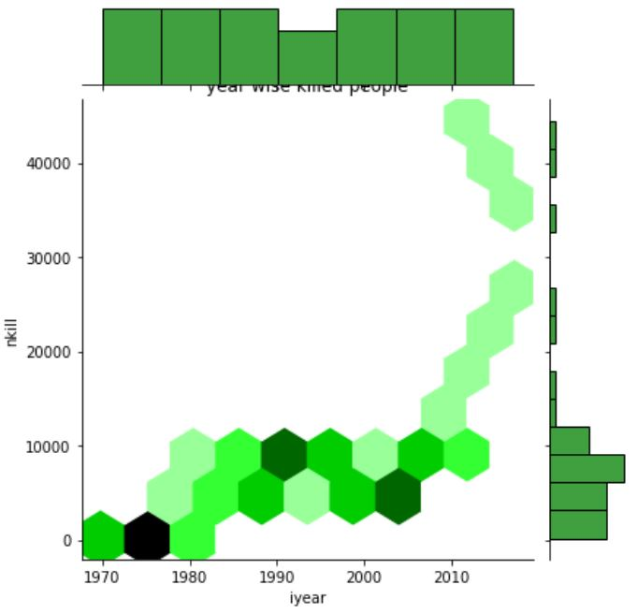
EDA
1.) Joint plot tells that
most people killed in 2014
2.) People killed in 2014
were more than 45000
3.) When compared to
all other years, least killed
happen in 1970

Slide 12
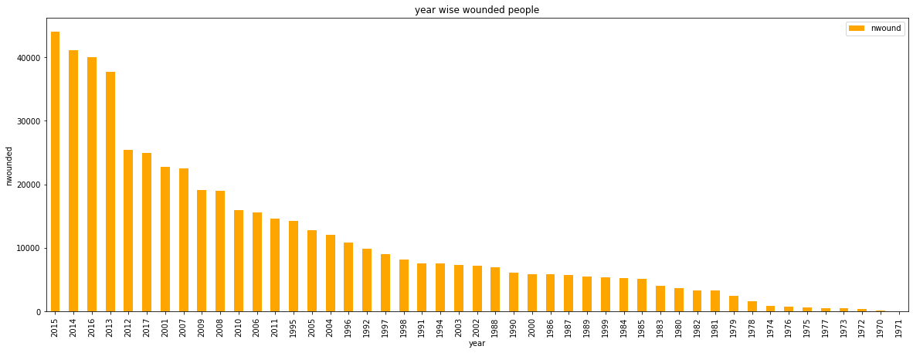
EDA
1.) Bar plot tells that most people wounded
in 2015
2.) People wounded in 2015 were more
than 44490
3.) When compared to all other years,
least wounded happen in 1970

Slide 13
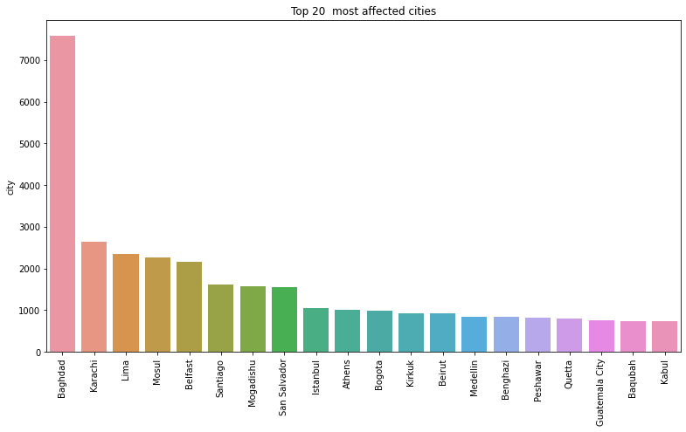
EDA
1.) Countplot tells that “Bagdad“ is the
most affected city in terrorist attacks.
2.) Bagdad contributes to 4.17% of all
terrorist activities
3.) When compared to all other cities,
“Kabul" is the lowest attacked
city in top 20 most attacked cities list

Slide 14
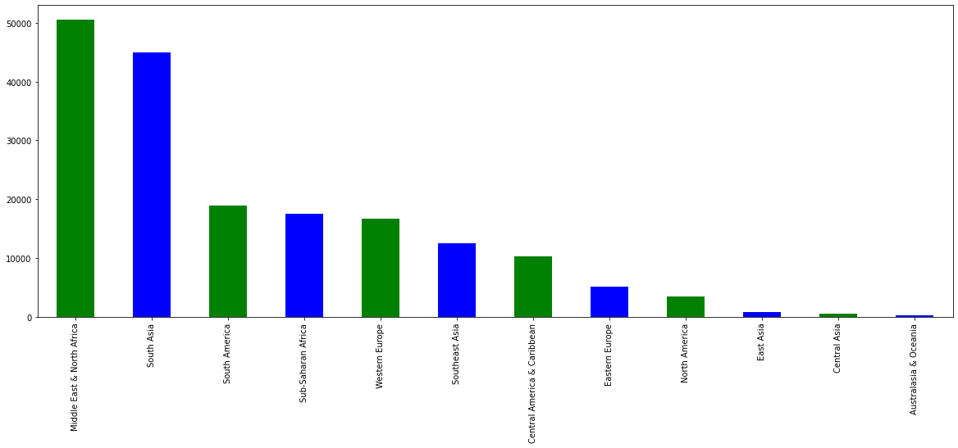
EDA
1.) Bar plot can conclude that most
terrorist attacked regional area was
Middle East & North Africa and its
number attacks were 50474.
2.) Lowest terrorist attacked regional
area was Australasia & Oceania and
its number of attacks were 282

Slide 15
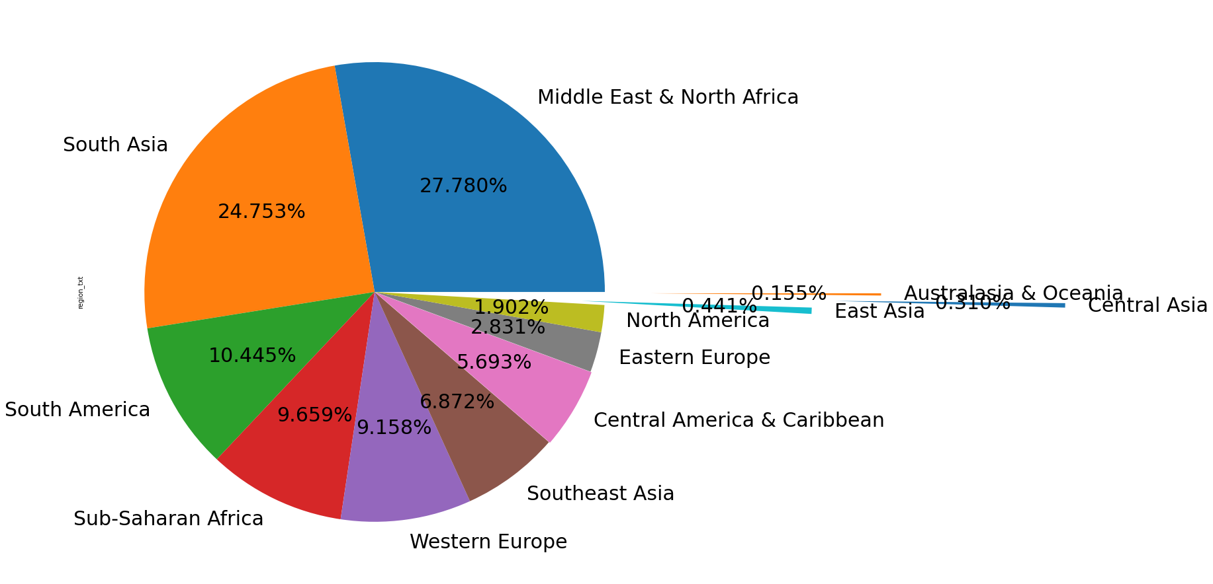
EDA
1.) From pie chart can conclude that most
terrorist attacked regional area was
Middle East & North Africa and its
percentage 27.780%
2.) Lowest terrorist attacked regional
area was Australasia & Oceania and
its percentage was 0.155%

Slide 16
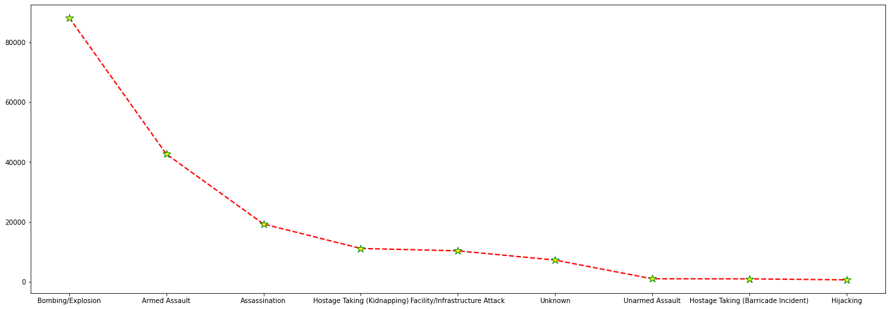
EDA
1.) From the line diagram We can conclude that most
frequent attack type from
1970 to 2017 was
"Bombing/Explosion"
2.) This type of attack was used
88255 times
3.) Least type of attack was "Hijacking“
and it was used only 659 times

Slide 17
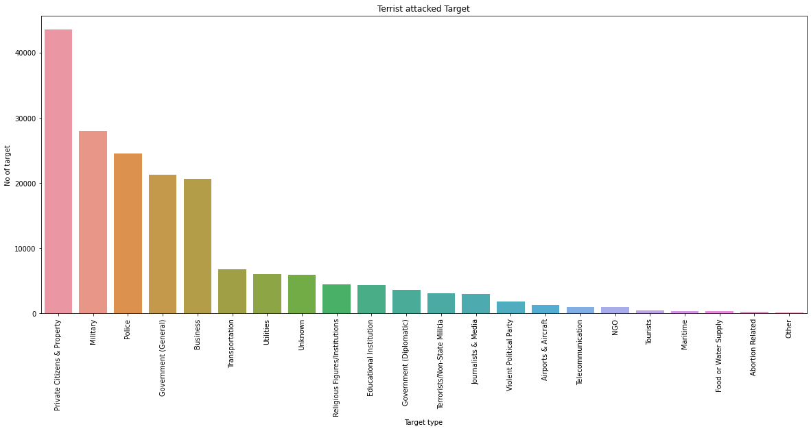
EDA
1.) From Bar plot ,We can conclude that
from 1970 to 2017,terrorist main
target was "Private Citizens &
Property“
2.) Till 2017 they targeted 43511 times
on private citizens & property,
3.) Second targeted "Military" 27984
times

Slide 18
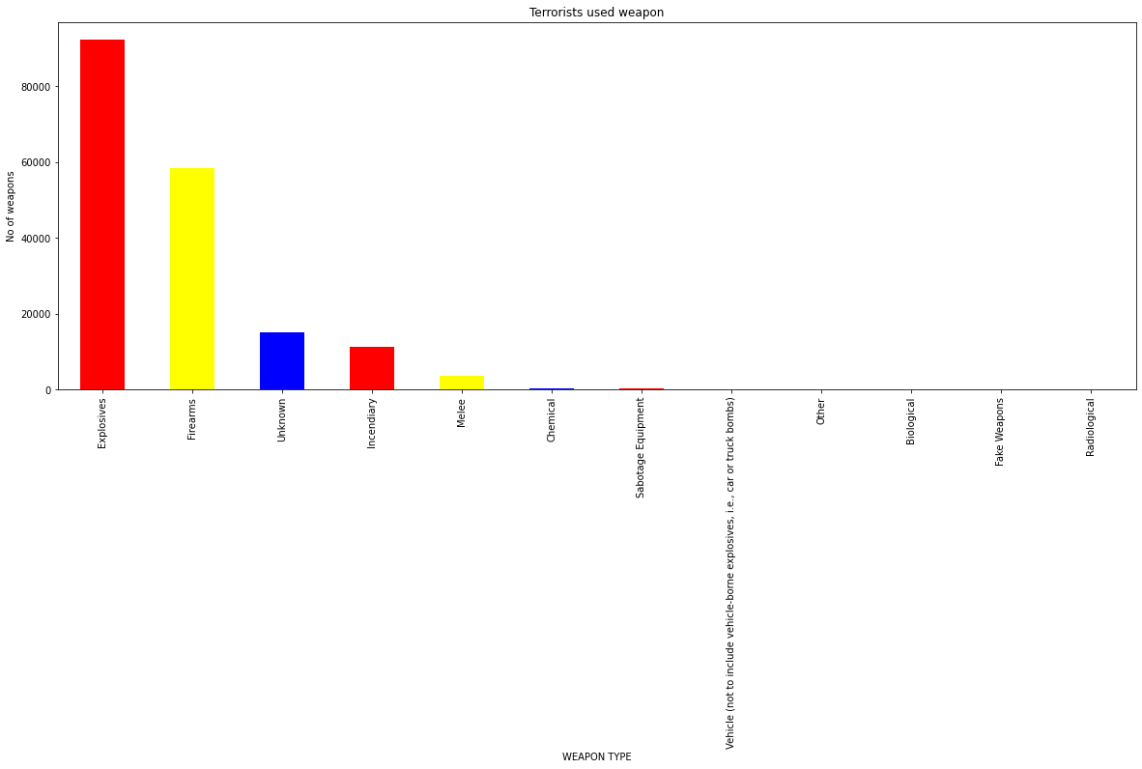
EDA
1.) From bar diagram We can conclude
that from 1970 to 2017, terrorists
mostly used weapon "Explosives"
2.) Explosives has been used 92426
times
3.) Radiological weapons were used
least times.

Slide 19
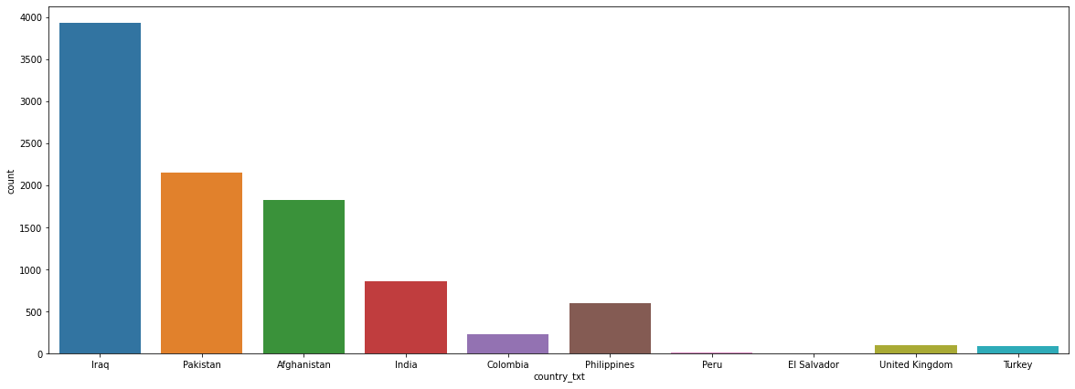
EDA
1.) From Bar plot,We can conclude
that in 2014, IRAQ was attacked
most 3933 times.
2.) EL Salvador was attacked least
times.

Slide 20
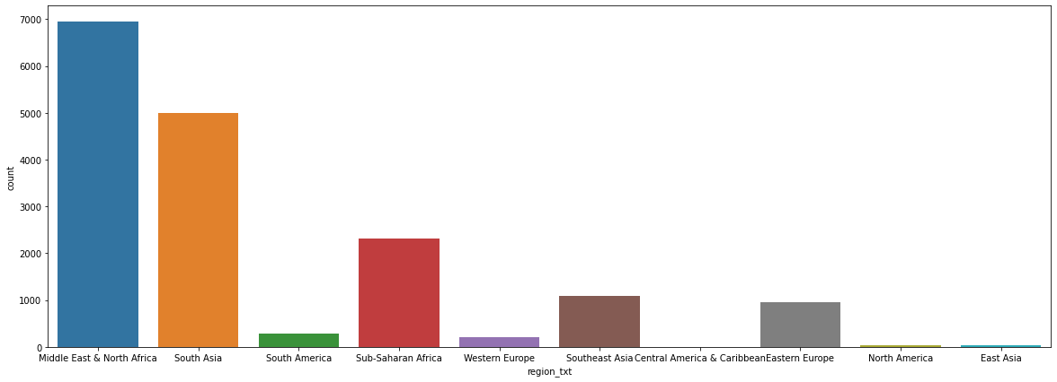
EDA
1.)From Bar plot, We can conclude
that in 2014, region “Middle East
and North America” was attacked
most.
2.) East Asia region was attacked
least times.

Slide 21
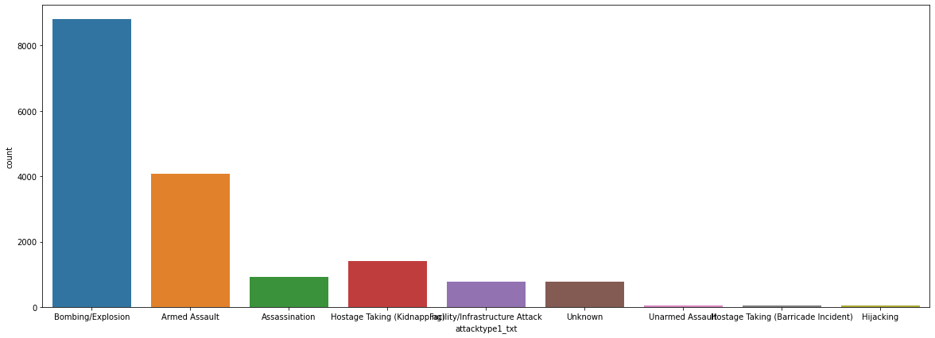
EDA
1.)From Bar plot, We can conclude
that Bombarding has been used
most in terrorist activities.
2.) Hostage type attack was used
least times.

Slide 22
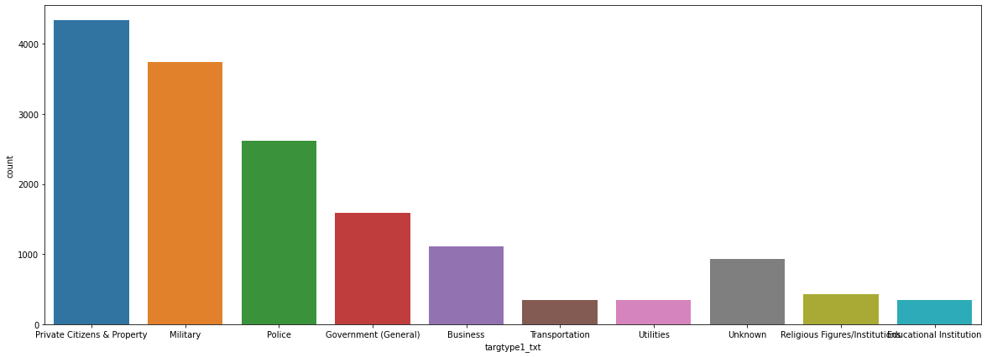
EDA
1.) From Bar plot,We can conclude
that Private citizen and property
was attacked most of the times
2.) Tourist place were attacked least.

Slide 23
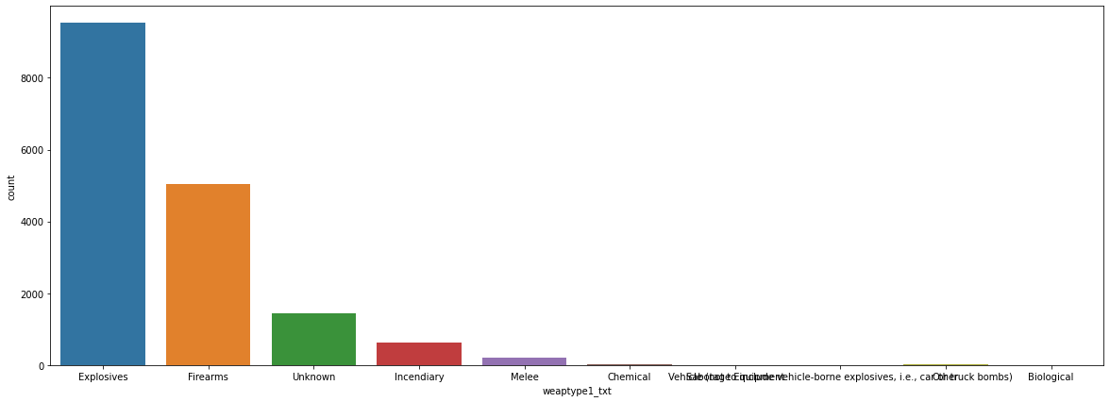
EDA
1.) From Bar plot, We can conclude
that explosive weapons were
used most of the times
2.) Sabotage weapons were used
least.

Slide 24
Conclusions
Observations:
1.) Year wise Attacks:
(i). Most number of attacks :16903 in 2014 (ii). Least number of attacks: 471 in 1971
2.) Region wise Attacks:
(i). Most number of attacks: 50474 in Middle East & North Africa (percentage is 27.78%) (ii). Least number of attacks: 282 in Australasia & Oceania (percentage is 0.15%)
3.) Country wise Attacks:
(i). Most number of attacks: 24636 in “Iraq” (percentage is 24.7%) (ii). Least number of attacks: 4292 in “Turkey” (percentage is 4.3%)
4.) City wise attacks: (i).most number of attacks: city was Baghdad and 7589 number of times attacked
5.) No.of people killed: (i). most people killed from 1970 to 2017 in Middle East & North Africa its number was 1,37,642 (ii).most number of people killed in 2014 its number was 44490

Slide 25
Contd…...
6.) No.of people wounded:
(i). most people wounded from 1970 to 2017 in Middle East & North Africa its number was 214308 (ii). most number of people wounded in 2015 its number was 44043
7.) Attack type wise attacks: (i). Most number of attacks :88255 by “Bombing /Explosion” (ii). Least number of attacks: 659 by “Hijacking “
8.) Target type wise attacks: (i). Most number of attacks: 43511 over “Private Citizens & Property” (ii). Least number of attacks: 263 over “Abortion Related”
9.) Weapons used in attacks: (i). Most number of weapons in attack: 92426 times Explosives are used (ii) Least number of weapons in attack: 14 times Radiological are used
10.) 2014-year attack (Most number of attacks): (i). Country: number of attacks are 3933 in “Iraq” (ii). Region: number of attacks are 6939 in “Middle East & North Africa” (iii). Type of attack: 8799 by Bombing /Explosion are used Mostly (iv) Target type: 4331 over Private Citizens & Property (v) weapon type: 9521 Explosives are used

Slide 26
Q & A

